Slide 1
Data Science with Python
SUBMITTED BY : Pradeepthi Lakkavaram
ROLL NO : 19881A04H0
BRANCH: Electronics and communication
GMAIL: Dsundhara@gmail.com
INTERN AT : AnalytixLabs, Bangalore
DURATION: 30/07/2022-30/9/2022

Slide 2
Learning objective or Internship objective
Understanding the case study .
Accessing python, which provides functionality to deal with mathematics, statistics and scientific functions .
Accessing Tablue to analyze and prepare big data insights according to the given case study
Implementing the above knowledge and generating the required analysis.
TOOLS REQUIRED:
Tablue public
Jupyterlabs

Slide 3
Methodology
Business Understanding:
Problem in the business area needs to be thoroughly understood before it can be solved. A solid foundation created by business knowledge makes it easier to answer questions. We need to be clear about the precise issue we intend to address.
Analytic Understanding:
The analytical strategy to take should be chosen based on the business understanding discussed above. There are four possible approaches: There are four types of analysis:
1.Descriptive analysis(focuses on the current situation and the information provided)
2.Diagnostic analysis(focuses on statistical analysis, what is occurring and why it is occurring)
3. Predictive analysis(focuses on predictions about trends or likelihood of future events)
4. Prescriptive analysis(focuses on how one problem should be solved in general)

Slide 4
Data Understanding:
Data understanding is basically descriptive statistics calculates the measures that are used to data to access the content and quality of matter.
Evaluation:
Evaluation includes development. It examines the model's quality and determines whether it satisfies the business needs. It passes through a phase of diagnostic measurements and a phase of statistical significance testing (which ensures proper data processing and interpretation).

Slide 5
Learnings:
Python for Development:
Data analysis and data visualization are two common uses of Python. Many non-programmers, including accountants and scientists, have adopted Python because it's reasonably simple to learn and can be used for a number of common activities.
Probability Theory:
Probability theory is a subfield of mathematics that focuses on the study of random events. For data scientists who work with data that is subject to chance, it is a crucial ability. The application of probability theory enables the investigation of chance events since randomness exists everywhere.

Slide 6
Data Science Lifecycle:
Machine learning algorithms and statistical techniques are used in a comprehensive data science lifecycle process to produce improved prediction models. The process involves several common data science steps, including data extraction, preparation, cleaning, modelling, and evaluation, among others.
Numpy & Pandas:
While the NumPy module works with numerical data, the Pandas module primarily deals with tabular data. While the NumPy module gives a sophisticated object called Array, the Pandas library includes a few sets of robust tools like DataFrame and Series that are mostly used for data analysis.
Relational Databases:
Python-based practical data science. The pandas library with a different supplementary library for handling database connectivity allow us to connect to relational databases for data analysis.

Slide 7
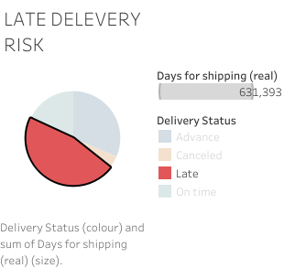
Result and discussions
The outputs of the required analysis are to be presented below using the given tools:
TABLUE:
fig1.1= Late delivery risk for sales and shipment dataset.

Slide 8
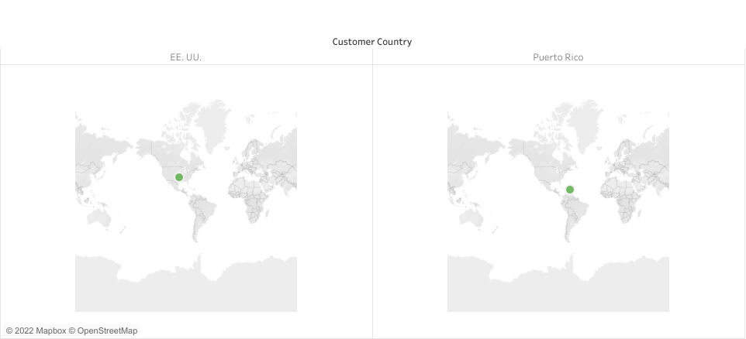
Fig 1.2: Costomer country for the sales and shipment dataset.

Slide 9
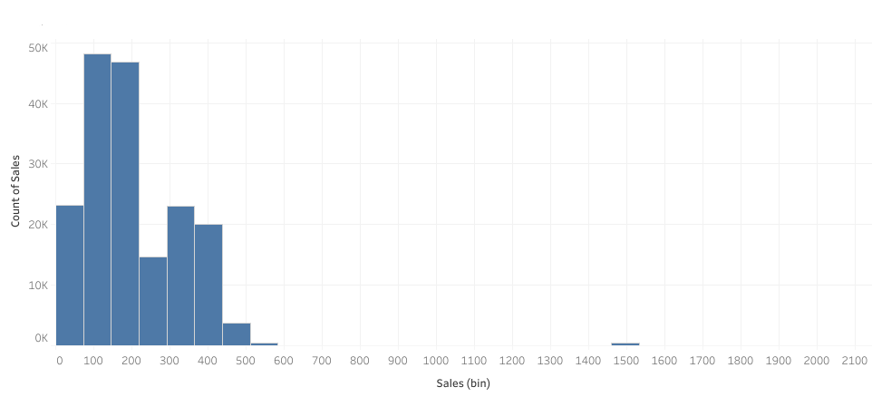
Fig1.3: count of sales per sales in avg

Slide 10
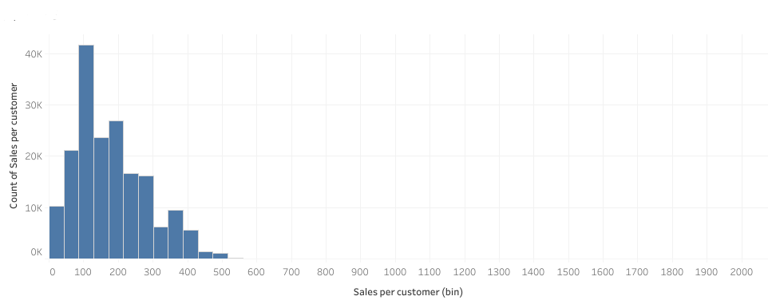
Fig1.4: count of sales per customer by sales per customer in avg

Slide 11
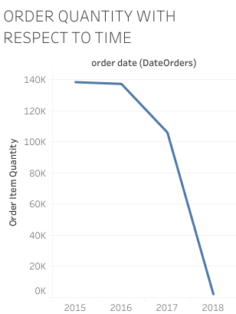
Fig1.5:Order quantity with respect to time

Slide 12
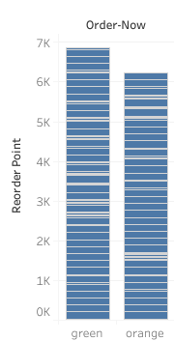
Fig1.6: Recorder point/order now of inventory stock dataset

Slide 13
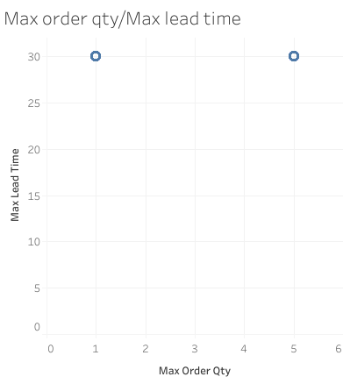
Fig1.7:Max order/order quantity of inventory stock dataset

Slide 14
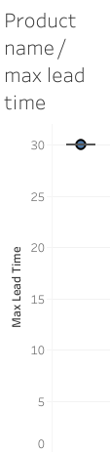
Fig1.8: Product name/max lead time quantity of inventory stock dataset

Slide 15
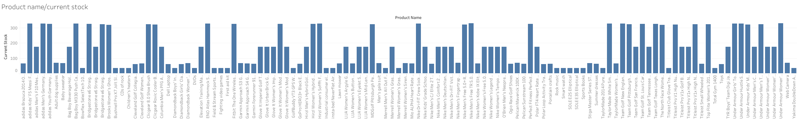
Fig1.9: Product name/ current stock quantity of inventory stock dataset

Slide 16
Jupyter labs:

Slide 17
THANK YOU!!

